Slide 1
Introduction To Programming
Arrays, structures and pointers

Slide 2
Pointers
A pointer is a variable that holds the value of a memory address.
Pointers are typed based on the type of element, that is stored at that address.
For an array, the pointer is always to the first element.
For a string, the pointer is to the first character.
Pointers support arithmetic, and will move 1 ”space” in memory according to the number applied.

Slide 3
Arrays
An array is a collection of elements of the same type stored contiguously in memory.
Declaration: type arrayName [ arraySize ];
where type is the storage type, name is the variable name, and arraySize is the capacity – how many elements it can store.

Slide 4
Arrays - initialization
int weekdays[7] = { 1, 2, 3, 4, 5, 6, 7 }
int workdays[] = {1, 2 ,3, 4, 5} //(the capacity for workdays is 5)

Slide 5
Arrays - access
Array elements are indexed starting from 0, and a single element can be accessed by referring to the correct index.
printf(”The 1st element is %d”, weekdays[0]);
printf(“The 3rd element is %d”, weekdays[2]);
weekdays[6] = 10; // set the last element to 10

Slide 6
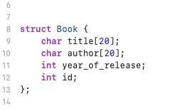
Structures
Structures allow for storage of different types of data grouped to create a logical entity in your software

Slide 7
Malloc – memory allocation
Library: stdlib.h
void * malloc(size_t size)
Allocates a block of memory specified by size and returns a pointer to it.
Used for dynamic allocation – variables, that are not defined at compile-time

Slide 8
Sizeof - get memory size
Library: stdio.h
size_t sizeof( type_or_variable );
If the argument for sizeof is a type, it returns the memory usage for that type
If the argument is a variable (or an expression) it returns the value of the expression.

Slide 9
Strcpy – copy one string to the other
Library: string.h
strcpy(char * string1, char * string2);
Copies the content of string2 into string1;

Slide 10
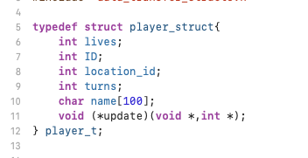
Typedefs

Slide 11
Yennefer’s library
Yennefer has asked you to create a way for her to manage her spell books. It should store up to 100 books, and the title, author, description and release year of each book. Create an interface that allows for adding new books to the library and listing the books added.

